Slide 1

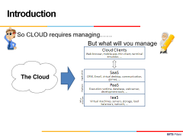
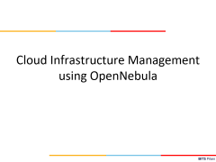
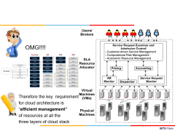
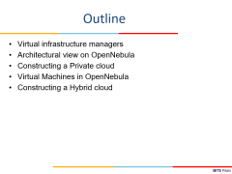
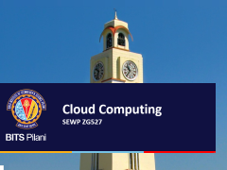
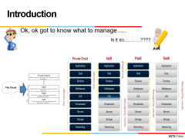
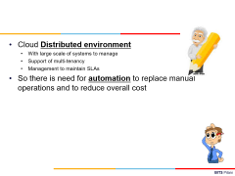
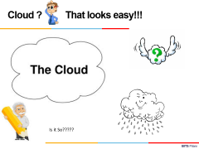
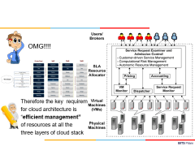
Cloud Computing
SEWP ZG527

Slide 2
Cloud Infrastructure Management using OpenNebula

Slide 3


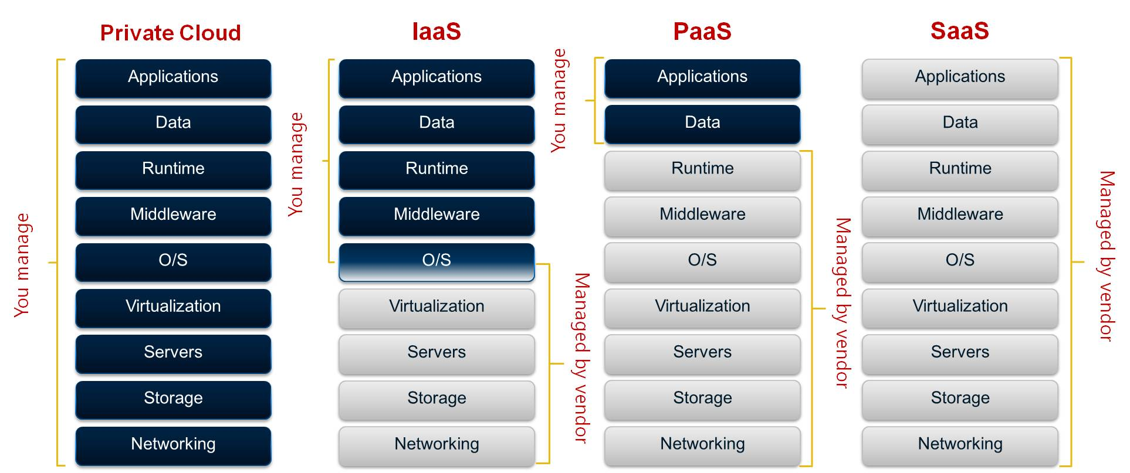
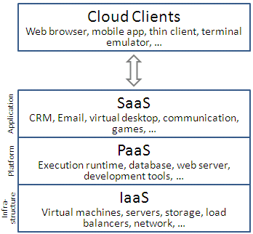

Introduction
Ok, ok got to know what to manage…..
Is it so………..????

Slide 4
Cloud Distributed environment
With large scale of systems to manage
Support of multi-tenancy
Management to maintain SLAs
So there is need for automation to replace manual operations and to reduce overall cost

Slide 5
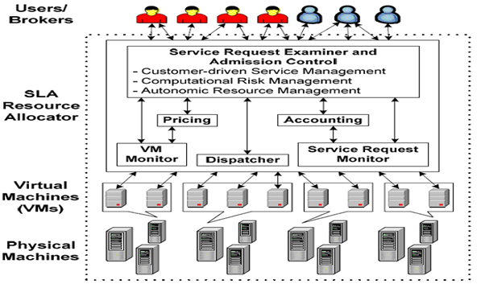
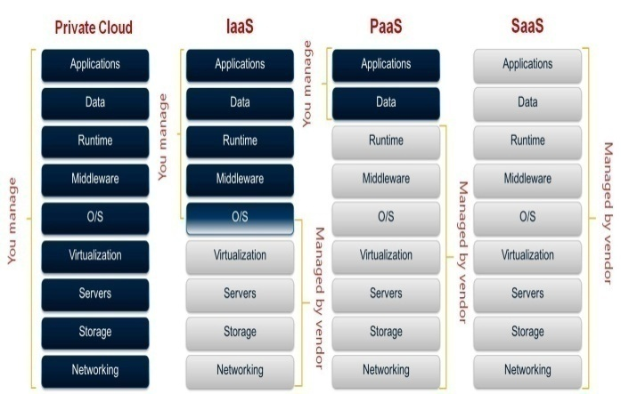
OMG!!!!
Therefore the key requirement
for cloud architecture is
“efficient management”
of resources at all the
three layers of cloud stack

Slide 6
Virtual Infrastructure Managers
Need of the hour???
Notes:
RL 6.2

Slide 7


Why a Virtual Infrastructure Manager?
VMs are great!!...but something more is needed
Where did/do I put my VM? (scheduling & monitoring)
How do I provision a new cluster node? (clone)
What IP addresses are available? (networking)
Provide a uniform view of the resource pool
Life-cycle management and monitoring of VM
The VIM should integrate Image, Network and Virtualization
VM
VM
VM
VM
OpenNebula (VIM)
hypervisor
hypervisor
hypervisor
hypervisor

Slide 8
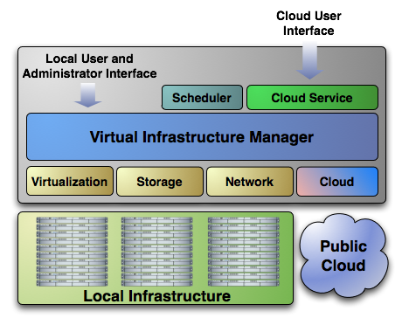
Extending the Benefits of Virtualization to Clusters
Dynamic deployment and re-placement of virtual machines on a pool of physical resources
Transform a rigid distributed physical infrastructure into a flexible and agile virtual infrastructure
Backend of Public Cloud: Internal management of the infrastructure
Private Cloud: Virtualization of cluster or data-center for internal users
Cloud Interoperation: On-demand access to public clouds
Notes:
8
Datacenters for flexibility providing services
Cloud providers willing to offer their static infrastructure

Slide 9
Virtual Machine Management Model
Distributed VM Management Model
Notes:
9
Datacenters for flexibility providing services
Cloud providers willing to offer their static infrastructure

Slide 10
What is OpenNebula?
Notes:
RL 6.3

Slide 11
What is OpenNebula?
OpenNebula is a cloud computing platform for managing heterogeneous distributed data center infrastructures. The OpenNebula platform manages a data center's virtual infrastructure to build private, public and hybrid implementations of Infrastructure as a Service
It’s a powerful, but easy-to-use, open source platform for your enterprise private, hybrid or edge cloud infrastructure, you are at the right place.
OpenNebula, the Cloud & Edge Computing Platform that unifies public cloud simplicity and agility with private cloud performance, security and control. OpenNebula brings flexibility, scalability, simplicity, and vendor independence to support the growing needs of your developers and DevOps practices

Slide 12
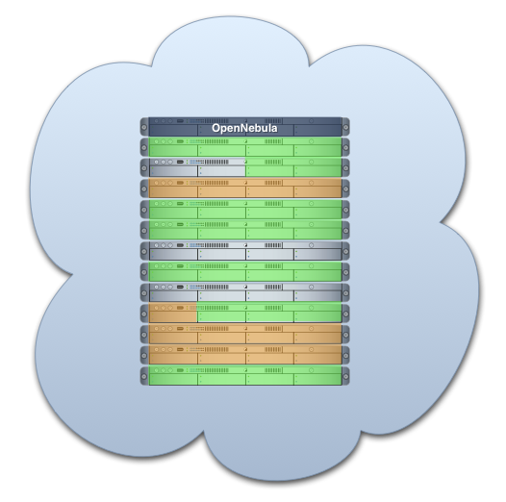


What is OpenNebula?
Enabling Technology to Build your Cloud
Private Cloud to simplify and optimize internal operations
Hybrid Cloud to supplement the capacity of the Private Cloud
Public Cloud to expose your Private to external users

Slide 13



What is the OpenNebula Open-Source Project?
Building the Industry Standard Open Source Cloud Computing Tool
Lead Innovation in Enterprise-Class Cloud Computing Management
Develop, maintain and assure the quality of OpenNebula
Collaborate with open-source and research projects and communities
Support the community and the ecosystem
An Active and Engaged Community
4,000 downloads/month
100 active contributors
OSS distribution channels
From a Research Project on Scalable Management of VMs:
Research
Project
v3.0
v3.4
TP1
v1.0
v1.2
v1.4
v2.0
v2.2
v3.2
2005 2006 2007 2008 2009 2010 2011 2012
European Funding

Slide 14
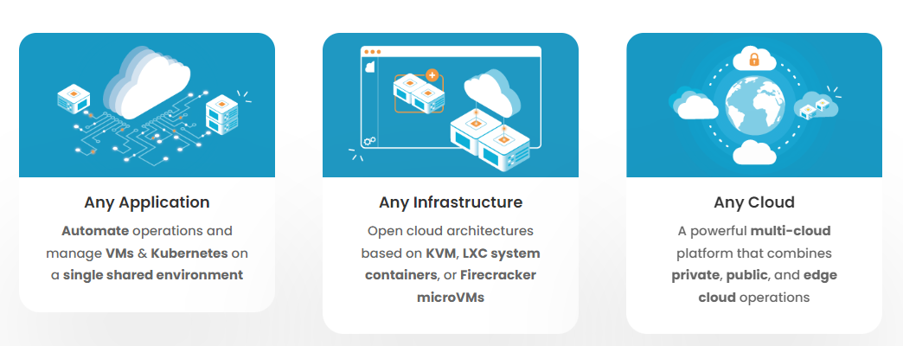
The Open Source Cloud & Edge Computing Platform for the Enterprise

Slide 15
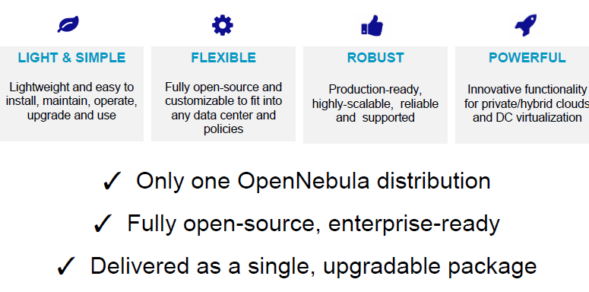
Open Nebula Technology

Slide 16
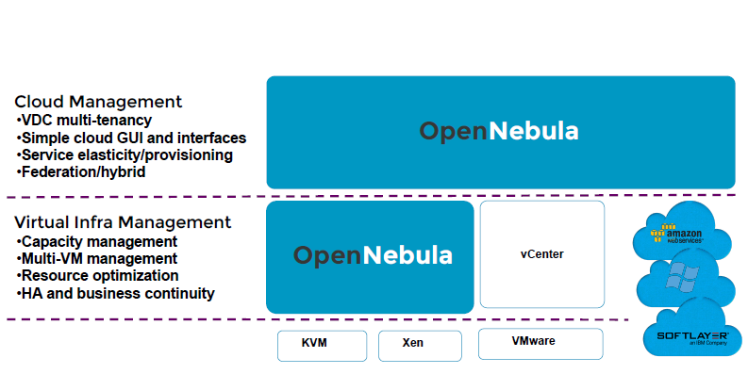
Open Nebula Features

Slide 17
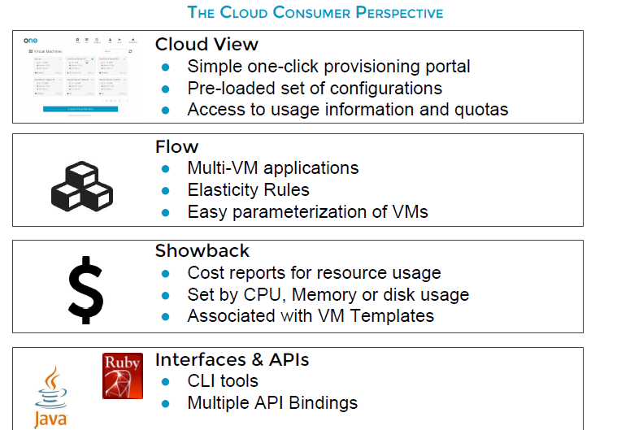
Open Nebula Features

Slide 18
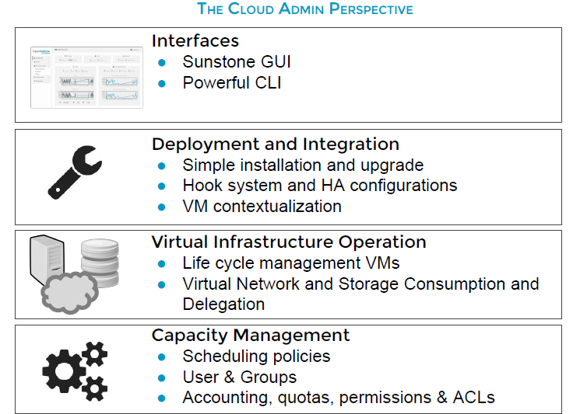
Open Nebula Features

Slide 19
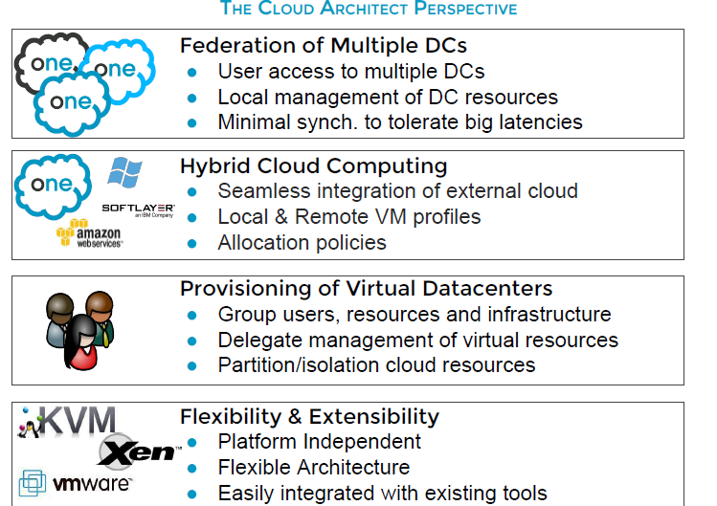
Open Nebula Features

Slide 20
The main features of OpenNebula
Feature | Function
Internal Interface | Unix-like CLI for fully management of VM life-cycle and physical boxes XML-RPC API and libvirt virtualization API
Scheduler | Requirement/rank matchmaker allowing the definition of workload and resource-aware allocation policies Support for advance reservation of capacity through Haizea
Virtualization Management | Xen, KVM, and VMware Generic libvirt connector (VirtualBox planned for 1.4.2)
Image Management | General mechanisms to transfer and clone VM images
Network Management | Definition of isolated virtual networks to interconnect VMs
Service Management and Contextualization | Support for multi-tier services consisting of groups of inter-connected VMs, and their auto-configuration at boot time
Security | Management of users by the infrastructure administrator
Fault Tolerance | Persistent database backend to store host and VM information
Scalability | Tested in the management of medium scale infrastructures with hundreds of servers and VMs (no scalability issues has been reported)
Flexibility and Extensibility | Open, flexible and extensible architecture, interfaces and components, allowing its integration with any product or tool
Notes:
Three types of features according to the different deployment models
About features…

Slide 21
OpenNebula Capability
For the Infrastructure Manager
Centralized management of VM workload and distributed infrastructures
Support for VM placement policies: balance of workload, server consolidation…
Dynamic resizing of the infrastructure
Dynamic partition and isolation of clusters
Dynamic scaling of private infrastructure to meet fluctuating demands
Lower infrastructure expenses combining local and remote Cloud resources
For the Infrastructure User
Faster delivery and scalability of services
Support for heterogeneous execution environments
Full control of the lifecycle of virtualized services management
Notes:
OpenNebula provides benefits for different stakeholders
For service managers, it provides
We will talk about this later, related to Green IT
Provides an open…
This allows its integration… cloud providers (we now have support for EC2 and EH), hypervisors (we have support for Xen, KVM), we provide our own VM image manager but…

Slide 22
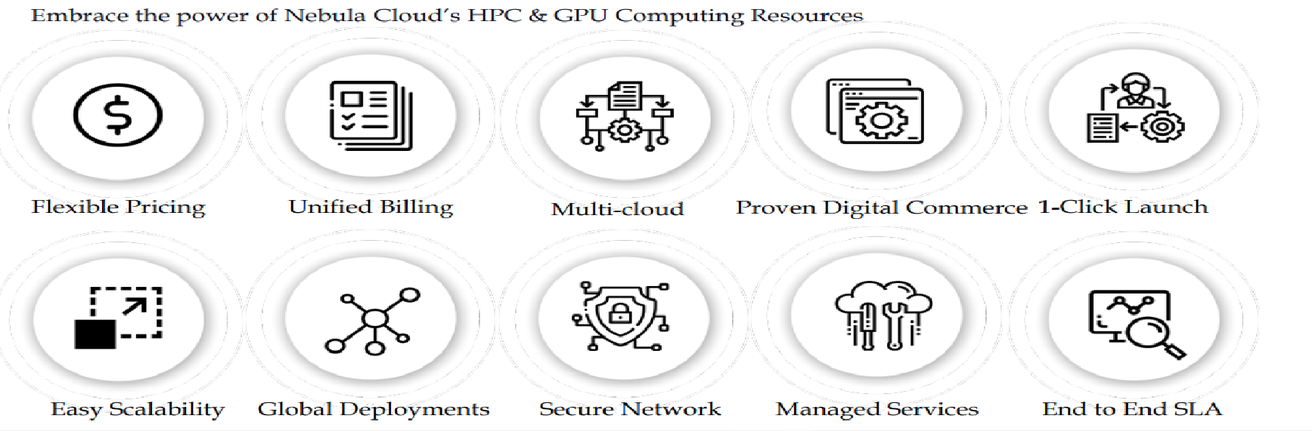
OpenNebula Cloud Model
Notes:
OpenNebula provides benefits for different stakeholders
For service managers, it provides
We will talk about this later, related to Green IT
Provides an open…
This allows its integration… cloud providers (we now have support for EC2 and EH), hypervisors (we have support for Xen, KVM), we provide our own VM image manager but…

Slide 23
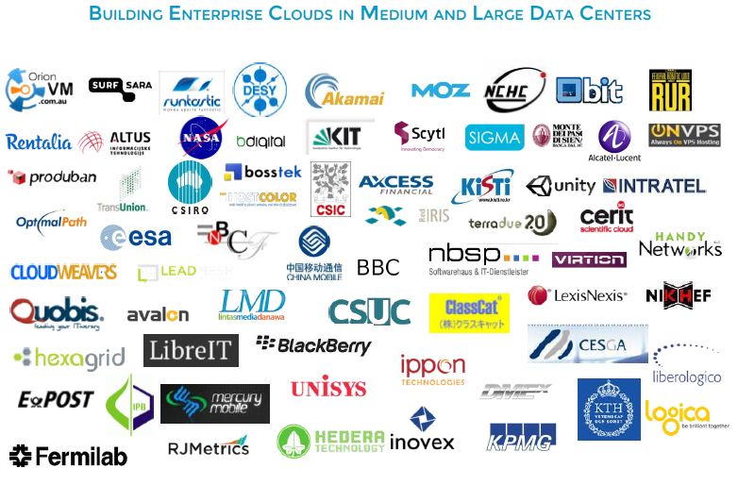
Open nebula Users

Slide 24
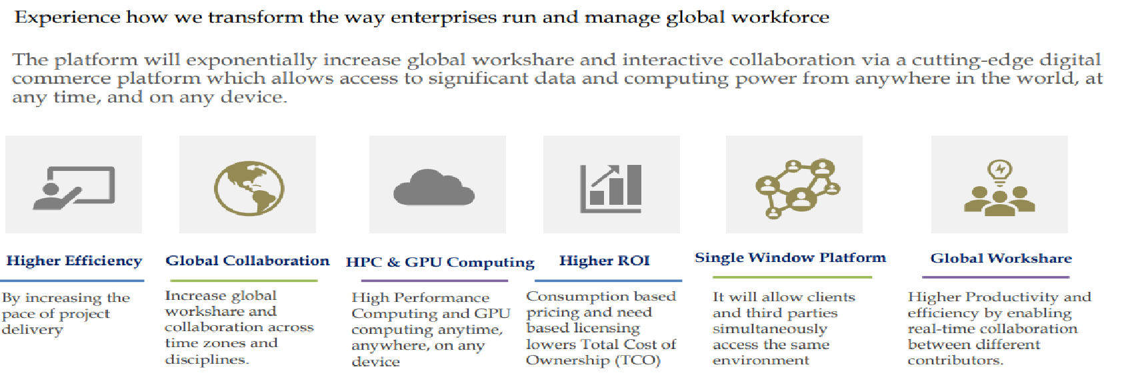
Nebula Cloud – A Cutting Edge Digital Collaboration Platform

Slide 25
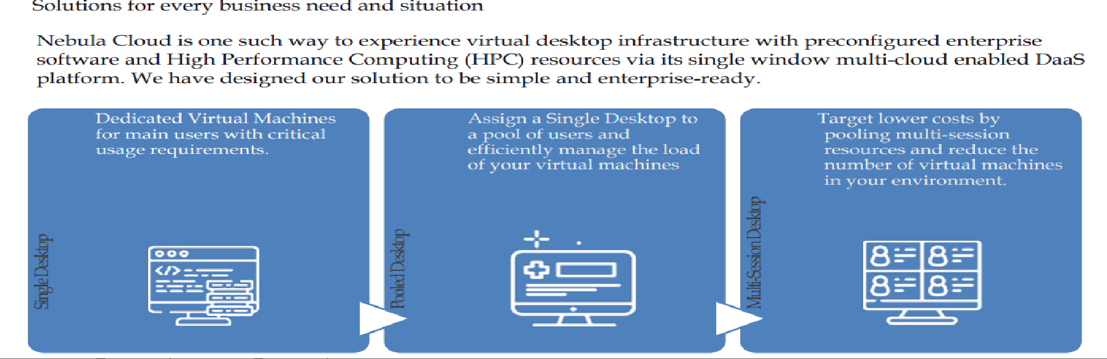
Nebula Cloud Deployment Model

Slide 26
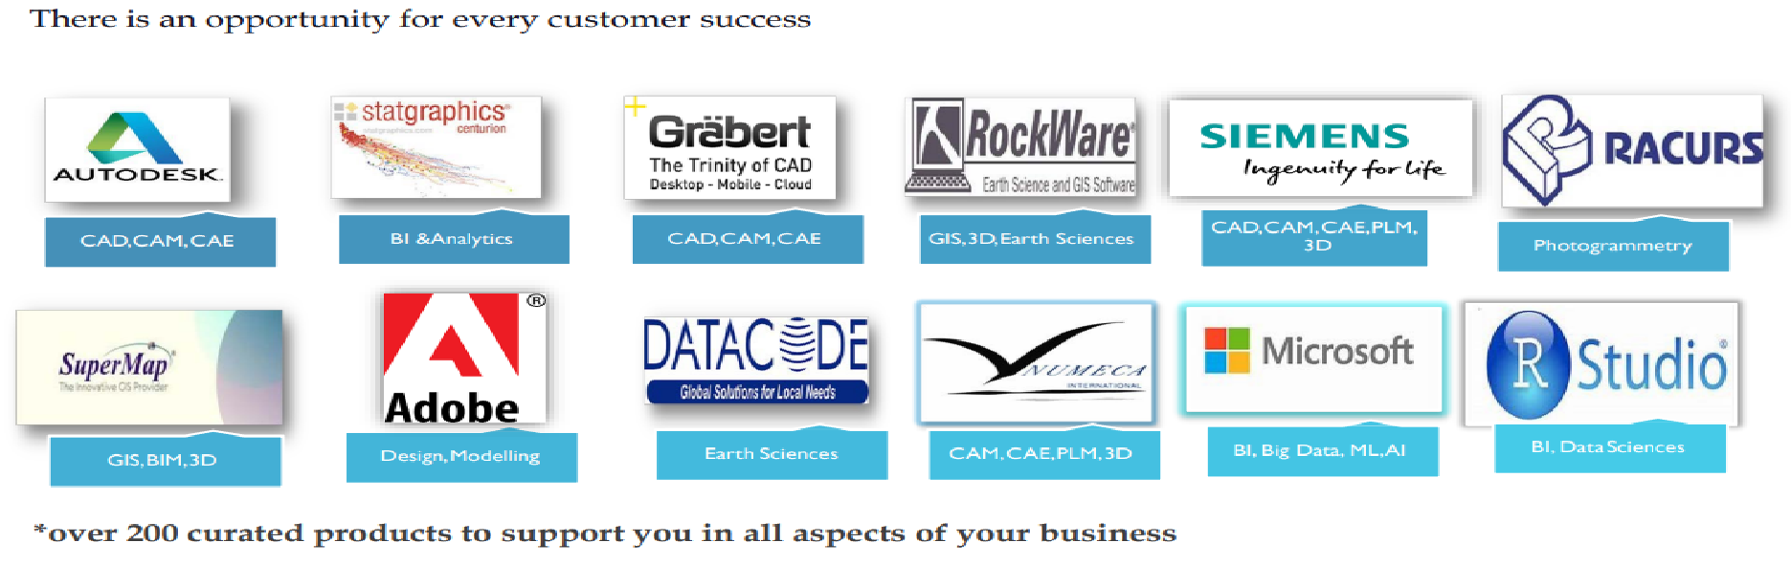
Some of The Premier Partners

Slide 27
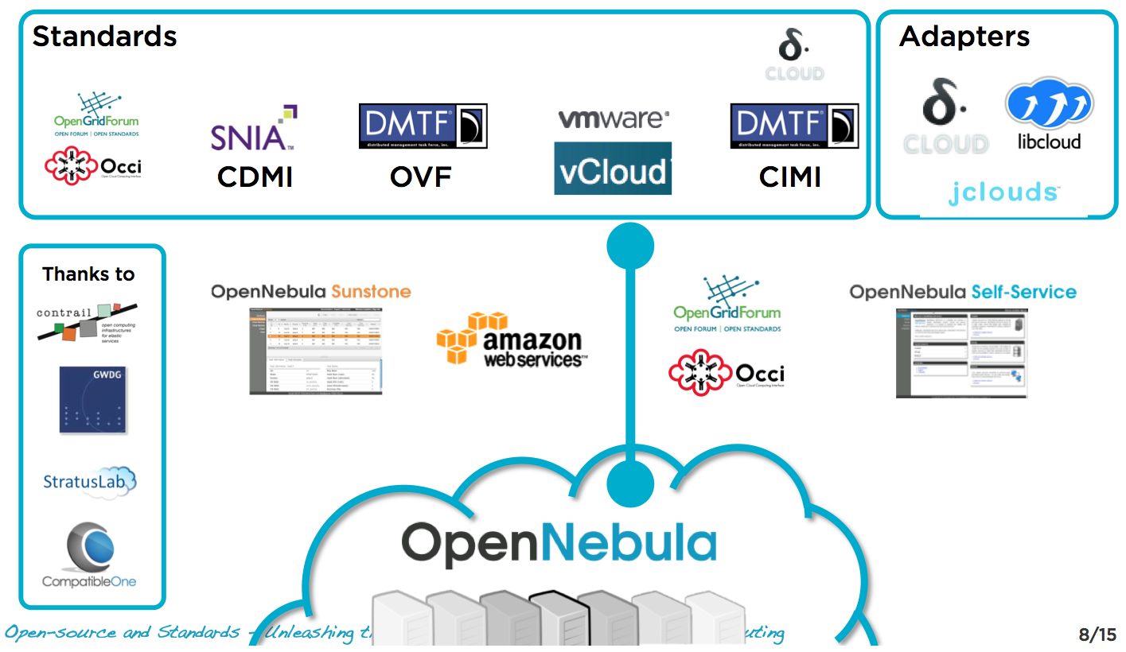
Interoperability From the Cloud Consumer Perspective
Standards (de facto and de jure) and adapters can be used to leverage existing ecosystems and ensure portability across providers....

Slide 28
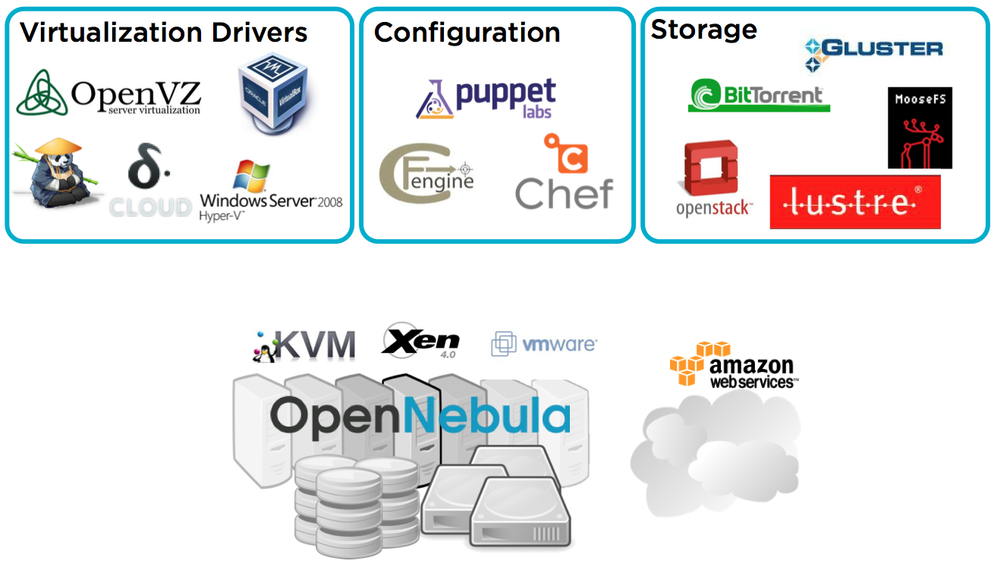
Interoperability from the Cloud Provider perspective
Interoperable (platform independent), innovative (feature-rich) and proven (mature to run in production).

Slide 29
The Benefits for System Integrators
Fits into any existing data center, due to its open, flexible and extensible interfaces, architecture and components
Builds any type of Cloud deployment
Open source software, Apache license
Seamless integration with any product and service in the cloud ecosystem and management tool in the data center, such as
cloud providers
VM managers
virtual image managers
service managers
management tools
schedulers
Notes:
OpenNebula provides benefits for different stakeholders
For service managers, it provides
We will talk about this later, related to Green IT
Provides an open…
This allows its integration… cloud providers (we now have support for EC2 and EH), hypervisors (we have support for Xen, KVM), we provide our own VM image manager but…

Slide 30
Comparison with Similar Technologies
 | Platform ISF | VMware Vsphere | Eucalyptus | Nimbus | OpenNebula
Virtualization Management | VMware, Xen | VMware | Xen, KVM | Xen | Xen, KVM, VMware
Virtual Network Management | Yes | Yes | No | Yes | Yes
Image Management | Yes | Yes | Yes | Yes | Yes
Service Contextualization | No | No | No | Yes | Yes
Scheduling | Yes | Yes | No | No | Yes
Administration Interface | Yes | Yes | No | No | Yes
Hybrid Cloud Computing | No | No | No | No | Yes
Cloud Interfaces | No | vCloud | EC2 | WSRF, EC2 | EC2 Query, OGF OCCI
Flexibility and Extensibility | Yes | No | Yes | Yes | Yes
Open Source | No | No | GPL | Apache | Apache

Slide 31
Inside OpenNebula
Notes:
RL 6.4

Slide 32
OpenNebula Architecture

Slide 33
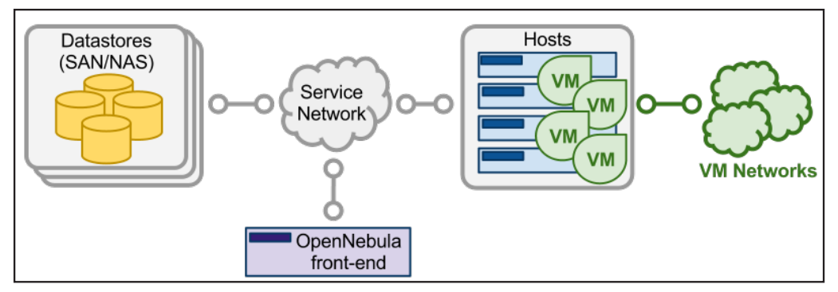
Open Nebula Architecture Diagram

Slide 34
The Core
Request manager: Provides a XML-RPC interface to manage and get information about ONE entities.
SQL Pool: Database that holds the state of ONE entities.
VM Manager (virtual machine): Takes care of the VM life cycle.
Host Manager: Holds handling information about hosts.
VN Manager (virtual network): This component is in charge of generating MAC and IP addresses.

Slide 35
The tools layer
Scheduler:
Searches for physical hosts to deploy newly defined VMs
Command Line Interface:
Commands to manage OpenNebula.
onevm: Virtual Machines
create, list, migrate…
onehost: Hosts
create, list, disable…
onevnet: Virtual Networks
create, list, delete…

Slide 36
The drivers layer
Transfer Driver: Takes care of the images.
cloning, deleting, creating swap image…
Virtual Machine Driver: Manager of the lifecycle of a virtual machine
deploy, shutdown, poll, migrate…
Information Driver: Executes scripts in physical hosts to gather information about them
total memory, free memory,
total #cpus, cpu consumed…

Slide 37
Process separation
Scheduler is a separated process, just like command line interface.
Drivers are also separated processes using a simple text messaging protocol to communicate with OpenNebula Core Daemon (oned)

Slide 38
Constructing a private cloud

Slide 39
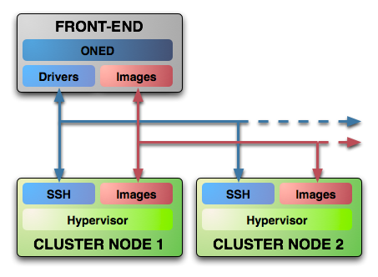
System Overview
Executes the OpenNebula Services
Usually acts as a classical cluster front-end
Repository of VM images
Multiple backends (LVM, iSCSI..)
Modular components to interact with the cluster services
Types: storage, monitoring, virtualization and network
The same host can be can be a the front-end and a node
Provides physical resources to VMs
Must have a hypervisor installed

Slide 40
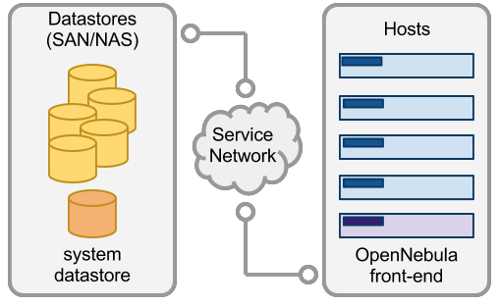
Complex Storage behind OpenNebula
Storage
Virtual machines and their images are represented as files
Datastore | Transfer Manager Drivers
 | shared | ssh | iscsi | qcow | vmware
System | OK | OK
File-System | OK | OK |  | OK
iSCSI |  |  | OK
VMware | OK | OK |  |  | OK
Virtual machines and their images are represented as block devices (just like a disk)

Slide 41
System Datastore with Shared Transfer Manager Driver
Storage
System
Datastore

Slide 42
Preparing the storage for a simple private cloud
Storage
Image Repository (system datastore): Any storage medium for the VM images (usually a high performing SAN)
OpenNebula supports multiple back-ends (e.g. LVM for fast cloning)
The front-end must have access to the repository
VM Directory: The home of the VM in the cluster node
Stores checkpoints, description files and VM disks
Actual operations over the VM directory depends on the storage medium
Should be shared for live-migrations
You can go on without a shared FS and use the SSH back-end
Defaults to $ONE_LOCATION/var/$VM_ID
Dimensioning the Storage... Example: A 64 core cluster will typically run around 80VMs, each VM will require an average of 10GB of disk space. So you will need ~800GB for /srv/cloud/one, you will also want to store 10-15 master images so ~200GB for /srv/cloud/images. A 1TB /srv/cloud will be enough for this example setup.

Slide 43
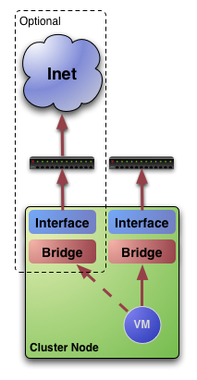
Networking for private clouds
Network
OpenNebula management operations use ssh connections
Image traffic, may require the movement of heavy files (VM images, checkpoints). Dedicated storage links may be a good idea
VM demands, consider the typical requirements of your VMs. Several NICs to support the VM traffic may be a good idea
OpenNebula relies on bridge networking for the VMs

Slide 44
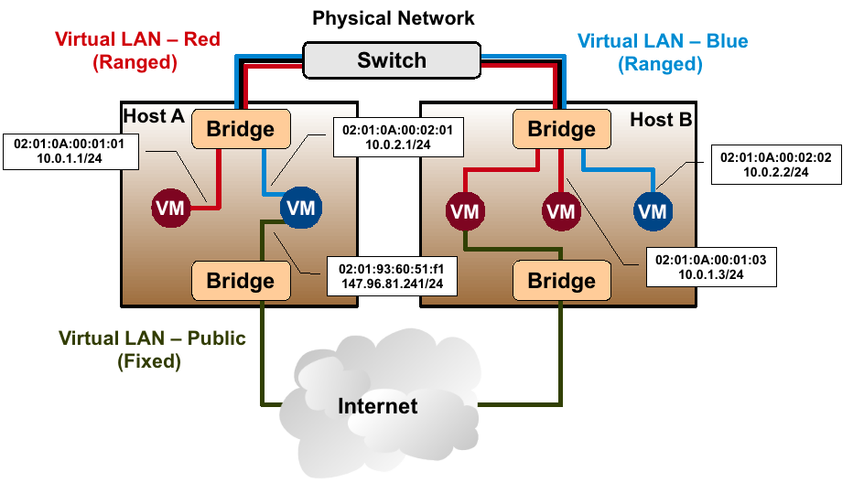
Example network setup in a private cloud
Network

Slide 45
Virtual Networks
Network
A Virtual Network in OpenNebula
Defines a separated MAC/IP address space to be used by VMs
Each virtual network is associated with a physical network through a bridge
Virtual Networks can be isolated (at layer 2 level) with ebtables and hooks
Virtual Networks are managed with the onevnet utility

Slide 46
Users
Users
A User in OpenNebula
Is a pair of username:password
Only oneadmin can add/delete users
Users are managed with the oneuser utility

Slide 47
User Management
Users
Native user support since v1.4
oneadmin: privileged account
Usage, management, administrative rights for:
Templates, VMs, Images, Virtual Networks
Through ACLs further operations/rights are available:
Rights for users, groups, datastores and clusters
Creation operation
SHA1 passwords (+AA module)
Stored in FS
Alternatively in environment

Slide 48
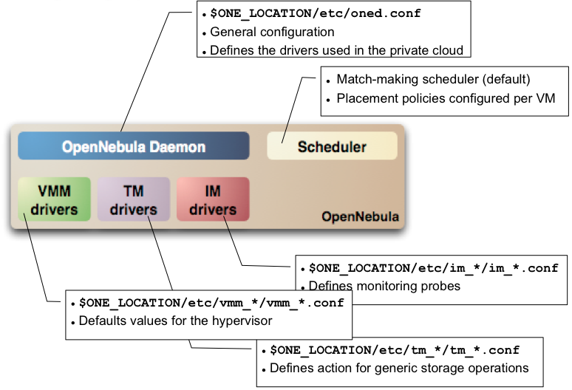
Configuration

Slide 49
Virtual machines

Slide 50
Preparing VMs for OpenNebula
VMs
Virtual Machines are managed with the oneuser utility
You can use any VM prepared for the target hypervisor
Hint I: Place the vmcontext script in the boot process to make better use of vlans
Hint II: Do not pack useless information in the VM images:
swap. OpenNebula can create swap partitions on-the-fly in the target host
Scratch or volatile storage. OpenNebula can create plain FS on-the-fly in the target host
Hint III: Install once and deploy many; prepare master images
Hint IV: Do not put private information (e.g. ssh keys) in the master images, use the CONTEXT
Hint V: Pass arbitrary data to a master image using CONTEXT

Slide 51
VM Description
VMs
Option | Description
NAME | Name that the VM will get for description purposes.
CPU | Percentage of CPU divided by 100 required for the Virtual Machine.
OS (KERNEL, INITRD) | Path of the kernel and initrd files to boot from.
DISK (SOURCE, TARGET, CLONE, TYPE) | Description of a disk image to attach to the VM.
NIC (NETWORK) | Definition of a virtual network the VM will be attached to.
Multiple disk an network interfaces can be specified just adding more disk/nic statements.
To create swap images you can specify TYPE=swap, SIZE=<size in MB>.
By default disk images are cloned, if you do not want that to happen CLONE=no can be specified and the VM will attach the original image.

Slide 52
VM States overview
VMs

Slide 53
Pending state
VMs
After submitting a VM description to ONE it is added to the database and its state is set to PENDING.
In this state IP and MAC addresses are also chosen if they are not explicitly defined.
The scheduler awakes every 30 seconds and looks for VM descriptions in PENDING state and searches for a physical node that meets its requirements. Then a deploy XML-RPC message is sent to oned to make it run in the selected node.
Deployment can be also made manually using the Command Line Interface:
onevm deploy <vmid> <hostid>

Slide 54
Prolog state
VMs
In PROLOG state the Transfer Driver prepares the images to be used by the VM.
Transfer actions:
CLONE: Makes a copy of a disk image file to be used by the VM. If Clone option for that file is set to false and the Transfer Driver is configured for NFS then a symbolic link is created.
MKSWAP: Creates a swap disk image on the fly to be used by the VM if it is specified in the VM description.

Slide 55
Boot state
VMs
In this state a deployment file specific for the virtualization technology configured for the physical host is generated using the information provided in the VM description file. Then Virtual Machine Driver sends deploy command to the virtual host to start the VM.
The VM will be in this state until deployment finishes or fails.

Slide 56
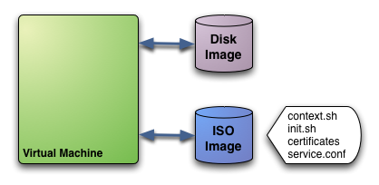
Contextualization
VMs
The ISO image has the contextualization for that VM:
context: contains configuration variables
init: script called by VM at start to configure specific services
certificates: directory that contains certificates for some service
service.conf: service configuration
User provided, OpenNebula provided contextualization info

Slide 57
Running and Shutdown states
VMs
While the VM is in RUNNING state it will be periodically polled to get its consumption and state.
In SHUTDOWN state Virtual Machine Driver will send the shutdown command to the underlying virtual infrastructure.

Slide 58
Epilog state
VMs
In EPILOG state the Transfer Manager Driver is called again to perform this actions:
Copy back the images that have SAVE=yes option.
Delete images that were cloned or generated by MKSWAP.

Slide 59
Hybrid cloud

Slide 60
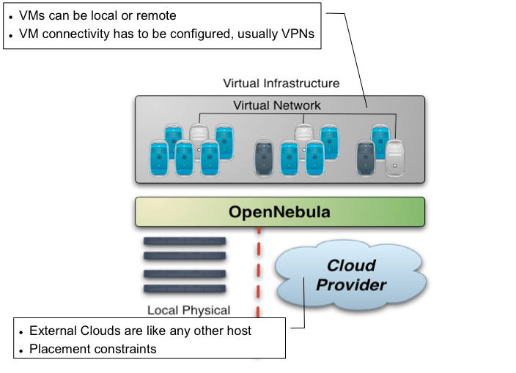
Overview

Slide 61
Making an Amazon EC2 hybrid
Amazon EC2 cloud is managed by OpenNebula as any other cluster node
You can use several accounts by adding a driver for each account (use the arguments attribute, -k and -c options). Then create a host that uses the driver
You can use multiple EC2 zones, add a driver for each zone (use the arguments attribute, -u option), and a host that uses that driver
You can limit the use of EC2 instances by modifying the IM file
Notes:
Create your EC2 hybrid cloud by adding a new host
$ onehost create ec2 im_ec2 vmm_ec2 tm_dummy
$ onehost list
ID NAME RVM TCPU FCPU ACPU TMEM FMEM STAT
0 84.21.x.y 0 200 200 200 2017004 1667080 on
1 84.21.x.z 1 200 200 200 2017004 1681676 on
2 ec2 0 500 500 500 8912896 8912896 on

Slide 62
Using an EC2 hybrid cloud
Virtual Machines can be instantiated locally or in EC2
The VM template must provide a description for both instantiation methods.
The EC2 counterpart of your VM (AMI_ID) must be available for the driver account
The EC2 VM template attribute should describe not only the VM’s properties but the contact details of the external cloud provider

Slide 63
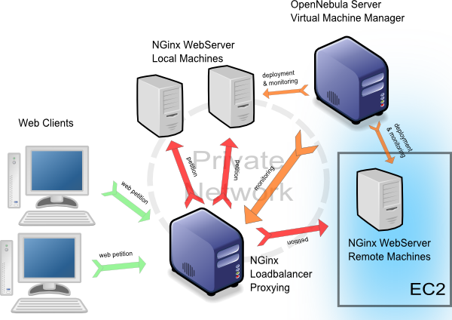
Hybrid cloud Use Case
On-demand Scaling of Computing Clusters
On-demand Scaling of Web Servers
Elastic execution of the NGinx web server
The capacity of the elastic web application can be dynamically increased or decreased by adding or removing NGinx instances
Notes:
In order to illustrate the functionality provided by OpenNebula, we have developed some use cases. For example:
On-demand…. That is the …This use case demonstrates the dynamic,,,
On-demand… That is the … This use case illustrates how

Slide 64
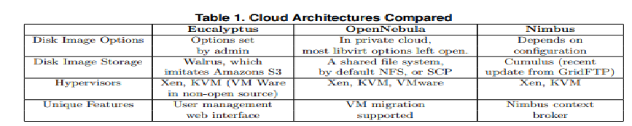
Open Source Cloud Services

Slide 65
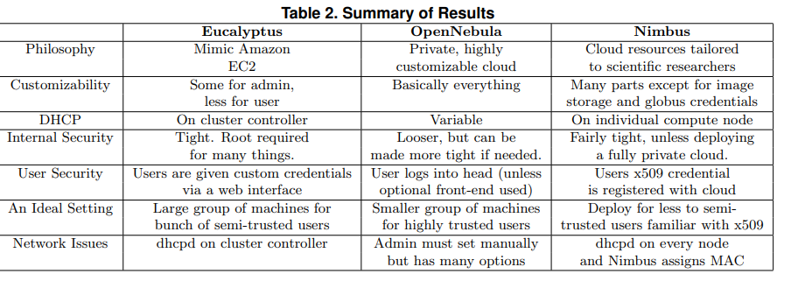
Summary of Open Cloud Services

Slide 66
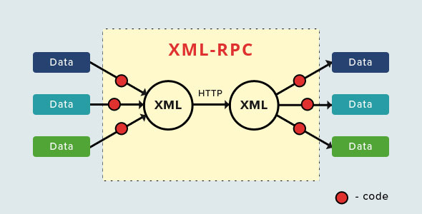
XML-RPC communication

